Slide 1

ANKARA UNIVERSITY
COMPUTER ENGINEERING
INTERNSHIP INFORMATION SYSTEM
Student Number: 16290126, 17290074, 17290114
Student Name SURNAME: Ozan ŞIK, Mert Can AK, Ahmet Said ÖZDEMİR
Supervisor Name SURNAME : Kurtuluş KÜLLÜ
Ankara 22.01.2021

Slide 2

CONTENTS
1. INTRODUCTION
1.1. Problem Definition
1.2. Aim of the Project
2. LITERATURE
3. MATERIAL and METHOD
3.1. Material
3.2. Method
4. EXPERIMENTS
5. CONCLUSION
REFERENCES

Slide 3
1. INTRODUCTION
1.1. Problem Definition
Due to the difficulties and communication distress on both the student and the teacher side before the internship period, many students' internships are disrupted during this period. Students' internship days are calculated incorrectly, especially due to internship dates and holidays during the internship.
In addition, confusion occurs due to the fact that the necessary internship documents are not sent over a system. Therefore, students cannot easily obtain information about the status of internship procedures throughout the process.

Slide 4
1.2. Aim of the Project
The system should be aimed to ensure that students can deliver the necessary internship documents more easily and the internship coordinators can arrange the documents in a more organized and problem-free way.
Users should be able to easily register to the system and the information, that they submit should be displayed on the system. While users can access the system via the web, they should also be able to access the system from anywhere, thanks to the android application.
Especially, it is an important feature of the system to determine the unsuitable days during the internship dates and to make it easily adjustable in case of an error.

Slide 5

2. LITERATURE
"Effective university websites can increase conversions, strengthen institutional credibility and brand, improve user satisfaction, and save time and money. " says Katie Sherwin in an article which she published on April 23, 2016.
Information technology has been used as a means of communication in vocational schools but its optimal utilization in internship programs is still low.
The web-based internship system contains information features, schedules, signups, daily journals, portfolio reports, final reports, database backup and guidance systems. PHP, Bootstrap, CSS, HTML, JavaScript, MySQL database and Apache web server is a technology used to develop web-based internship information system.
Finest example of this subject is Information system of University of Notre Damme. Launched in 2012, the website was designed by an in-house team, and responsive design was among their top priorities.

Slide 6
3. MATERIAL and METHOD
3.1. Material
Our project is a web-based application for ease of access. Development for the web part was made with Node.js. Express.js, Handlebars.js, JWToken, etc. modules were included to facilitate some parts of the project. A MySQL database is used to store data from users.
In order to navigate the front-end of the system, the router method in the Express.js module of Node.js was used at the back-end. Visualization was provided within the site with CSS files.
The mobile application of the project was written in Java language over the Android Studio (version 4.0). Also, PHP was used in order to connect the application to the database.

Slide 7
3.2. Method
During the development process, the Agile Development method was applied to the project. With the weekly presentations that we made with our mentor, new Requirements were determined and implemented each week.
During the project development stages, the source codes were shared by the group members on Github. In this way, an effective working environment was provided.

Slide 8
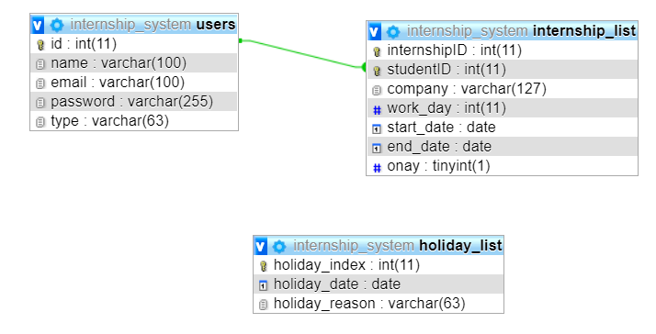
4. EXPERIMENTS
After entering the required information of the students or people with permission in the system, the MySQL database was used to keep this information.

Slide 9
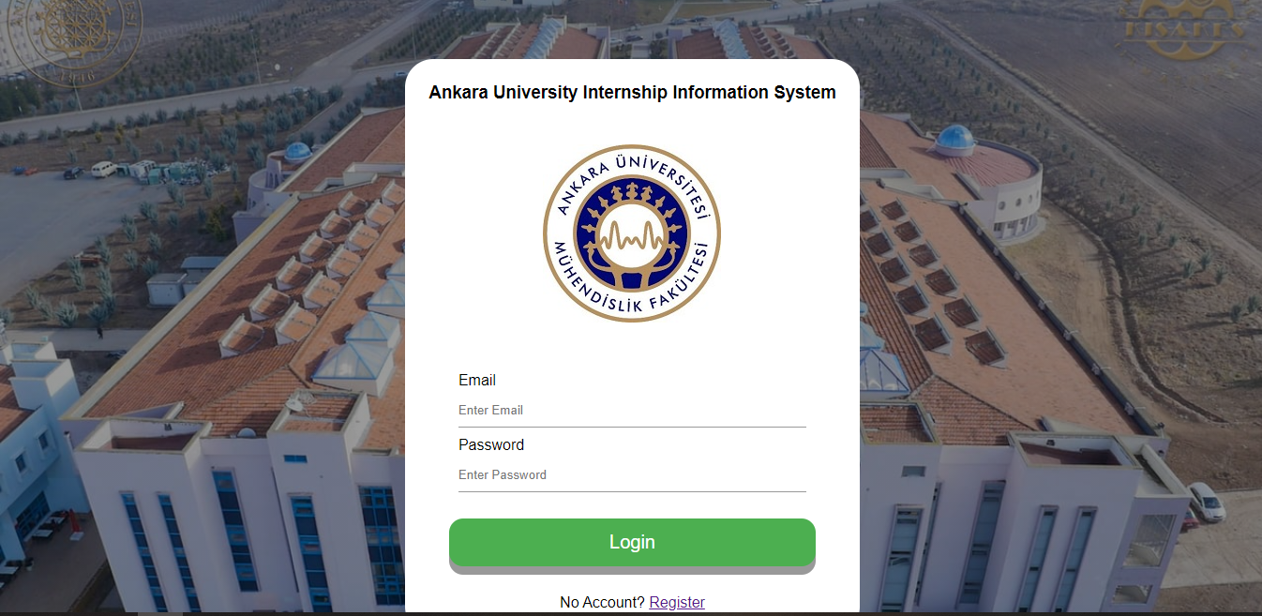
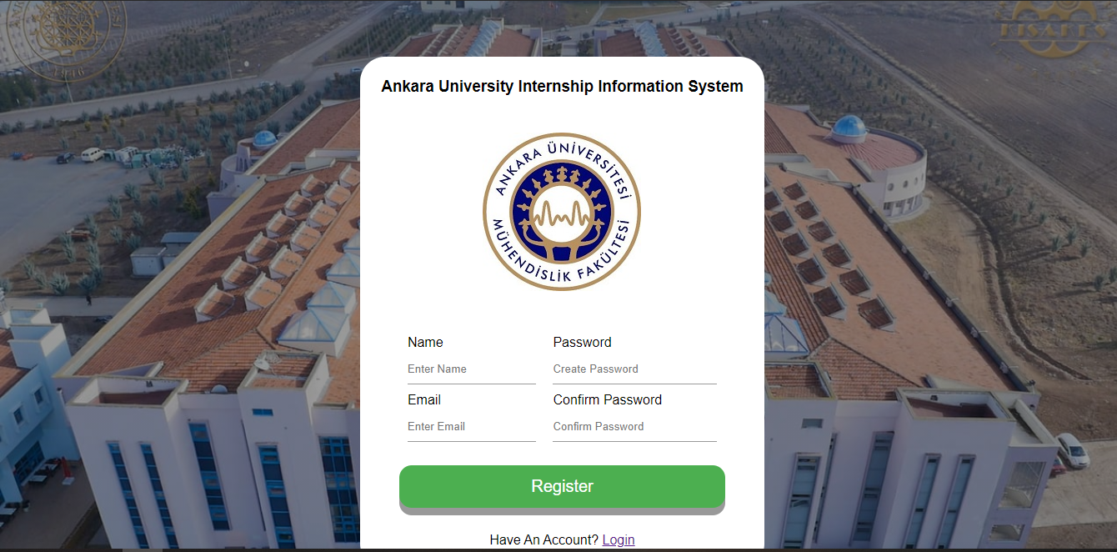
4. EXPERIMENTS
The first pages encountered when the system is opened are the login and register pages. Here, users can easily register and log into the system.

Slide 10
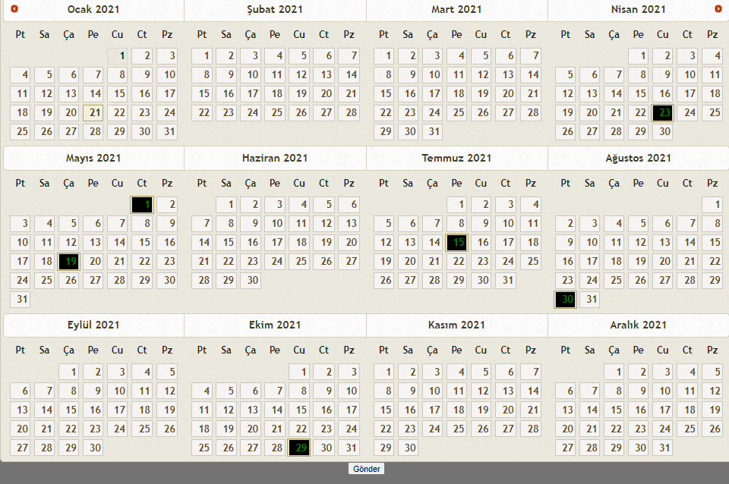
There are three user types in the system. These are student, teacher and admin.
If the user type is admin, the user can select the days that the internship cannot be done on the calendar shown in the figure.
At the same time, the calendar is used for students to choose their internship days.

Slide 11
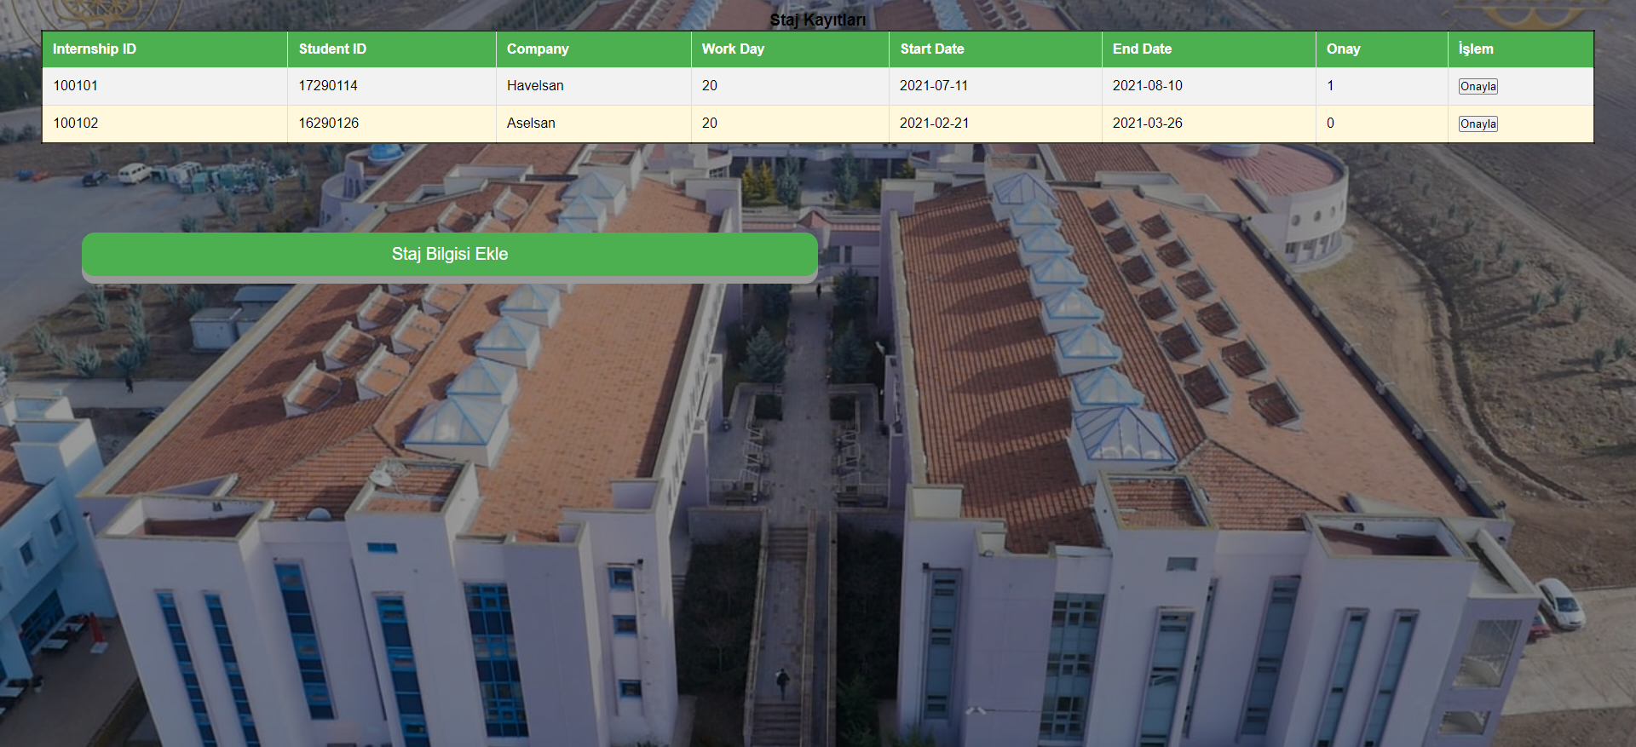
4. EXPERIMENTS
If the user type is teacher, all internships that students have entered are shown on the screen. In this way, the teacher can confirm or decline the internship on the incoming screen.

Slide 12
In mobile application segment of this system, user is faced with a home screen similar to the one in the figure, he/she can click the “login” or “signup” button.
On the signup page, the user is asked to provide his/her “fullname”, “email”, “username”, “password”. When values are provided and the “SIGNUP” button is clicked, values are pushed to the database.
Login page asks for only two values; “username” and “password”. The values will be passed to the database to check correctness.
The Login and SignUp pages also have a clickable text to redirect the user to the other page.
If the database returns “Login Success”, the user will be directed to the main page.

Slide 13
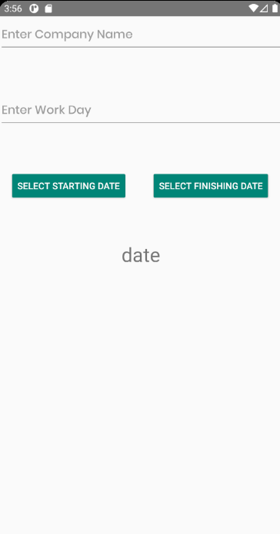
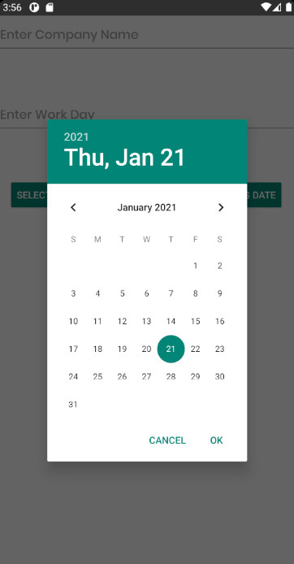
If the database returns “Login Success”, the user will be directed to the main page.
There is a button for students to add new internship records in the main page of the student side of the system.
When this button is clicked, the user will be redirected to a page that he/she can submit his/her internship records to the system.
The user can choose starting and finishing days of his/her internship from a calendar.

Slide 14
5. CONCLUSION
In the next semester, a file uploading and storing mechanism to allow users to provide the required internship documents to the system is planned to be added.
Some major changes and enhancements will be made to the User Interface.
Until this time, the group members focused on developing the web segment of the system. In the next semester, development of the mobile application will also be a main target.
Until now, we were not able to use a shared database among group members, (and also between mobile-web segments) because of domain problems, in the next semester, the system will be set up in a way that a shared database can be used.

Slide 15
REFERENCES
Booth, A., Papaioannou, D., & Sutton, A. (2012). Systematic approaches to a successful literature review
Messmann, G., & Mulder, R. H. 2015. Conditions for apprentices’ learning activities at work. Journal of Vocational Education & Training, 67(4), 578–596. https://doi.org/10.1080/13636820.2015.1094745
Conway, M.-L., & Foskey, R. 2015. Apprentices thriving at work: looking through an appreciative lens. Journal of Vocational Education & Training, 67(3), 332–348. https://doi.org/10.1080/13636820.2015.1054863
Y Yannuar et al 2018 IOP Conf. Ser.: Mater. Sci. Eng. 434 012301
December 2018IOP Conference Series Materials Science and Engineering 434(1):012301

Slide 16

ANKARA UNIVERSITY
COMPUTER ENGINEERING
THANK YOU
Student Number: 16290126, 17290074, 17290114
Student Name SURNAME: Ozan ŞIK, Mert Can AK, Ahmet Said ÖZDEMİR
Supervisor Name SURNAME : Kurtuluş KÜLLÜ

